Slide 1
Program Progress
Training Presentation

Slide 2
Program Progress Overview
Program Progress Table is a system used to capture Indicator activities and Indicator results
It captures the unit, district, county , the activity according to the activity and the number of men and women who took up in the activity.
Different indicators show whether its requires data as a combined total for men and women or if it’s a separate total capturing men and women.

Slide 3
PPT Modules
Home-Register user
Program Progress Tables
Manage forms
Maintenance
Targets/ baselines
Reports
Uploads
Help
Downloads

Slide 4
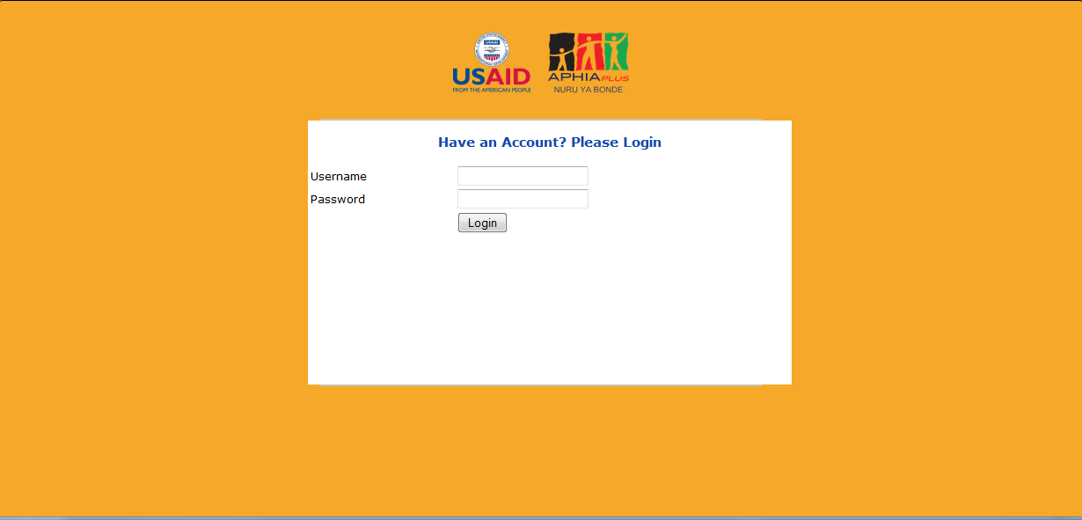
Login

Slide 5
Login Page
This page allows users to Login into the system. It requires users to enter the correct usernames and password as assigned by the admin or when the account was created.

Slide 6
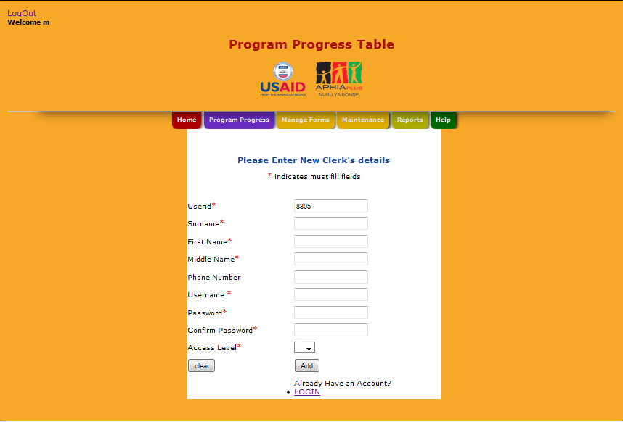
Register Data Clerk
UserID is auto-generated
Select accesslevel of 1 is data clerk or 2 is for admin

Slide 7
Register Data Clerk
This module will be used to register data clerk and admin.
The data clerk is given an access level of 1 while the admin is given an access level of 2.
The user id is auto generated by the system

Slide 8
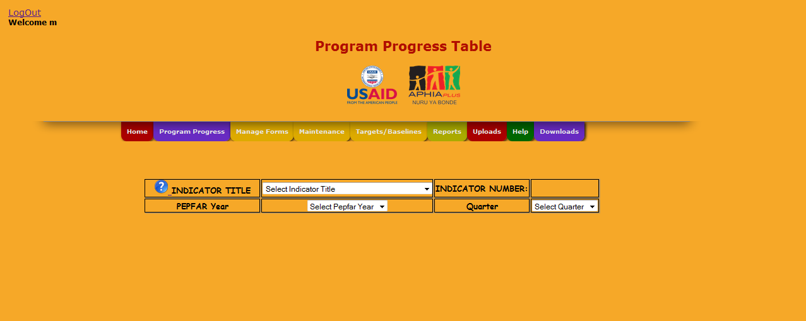
Program Progress Table

Slide 9
Program Progress Table
First select the indicator title , this filter out the indicator number
Then select the financial year you require to enter data for e.g. 2012, 201etc.
Then select the quarter which divides the year from Oct-Dec , Jan-March, April- June , July-Sept

Slide 10
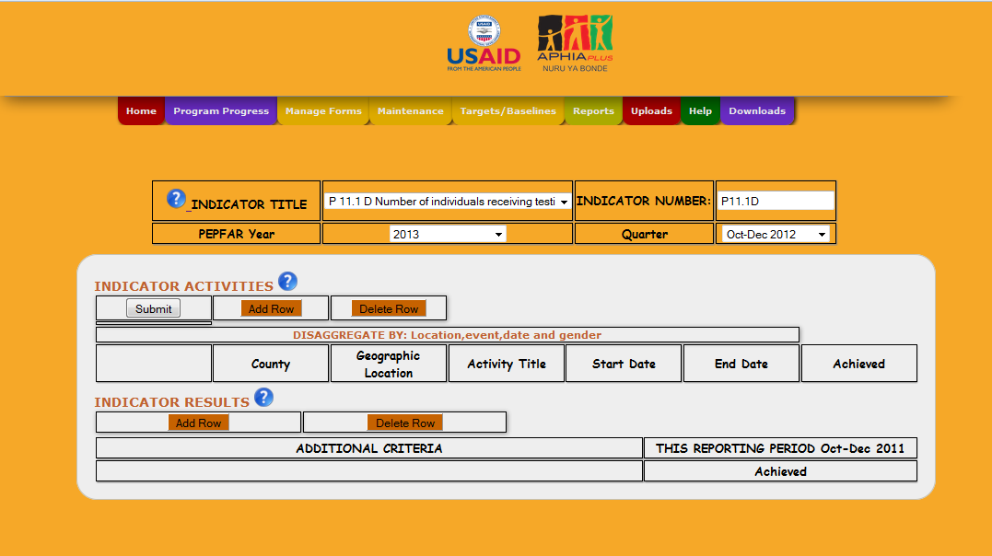
Data Entry Table(Combined)-User
Is combined

Slide 11
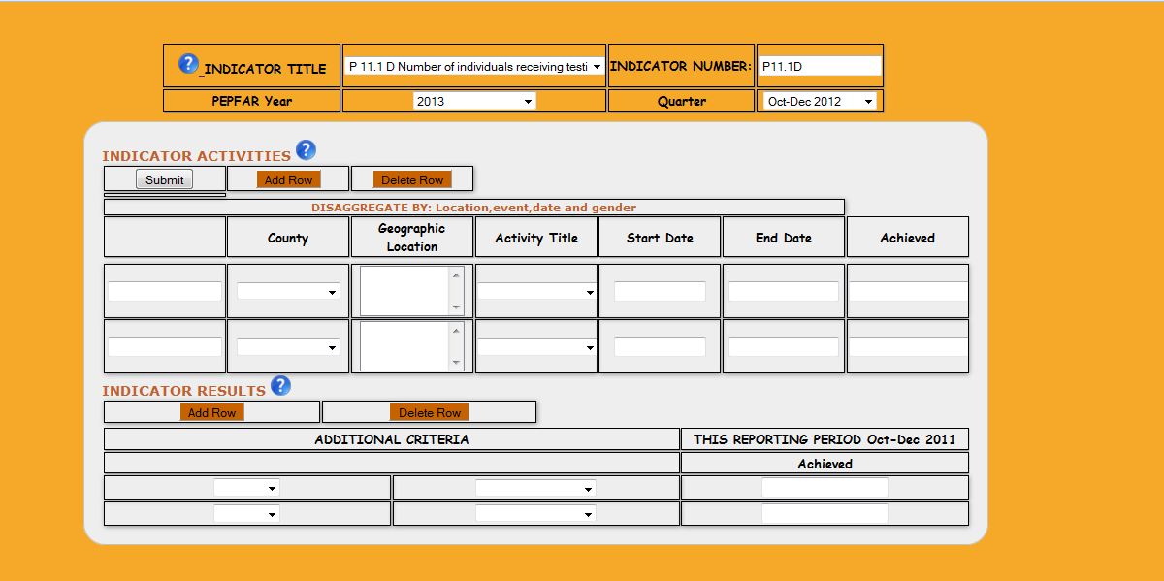
For data entry add the number of rows you want to enter data on then click submit to save the data

Slide 12
Data Entry for PPT with combined achieved
This page allows user to enter indicator activities.
To add rows to any of the sections i.e the activities and the results, click add row.
Enter the Unit, the county which filters the districts, the activity which is determined by the indicator.
The start date and end date and achieved number of trained people.

Slide 13
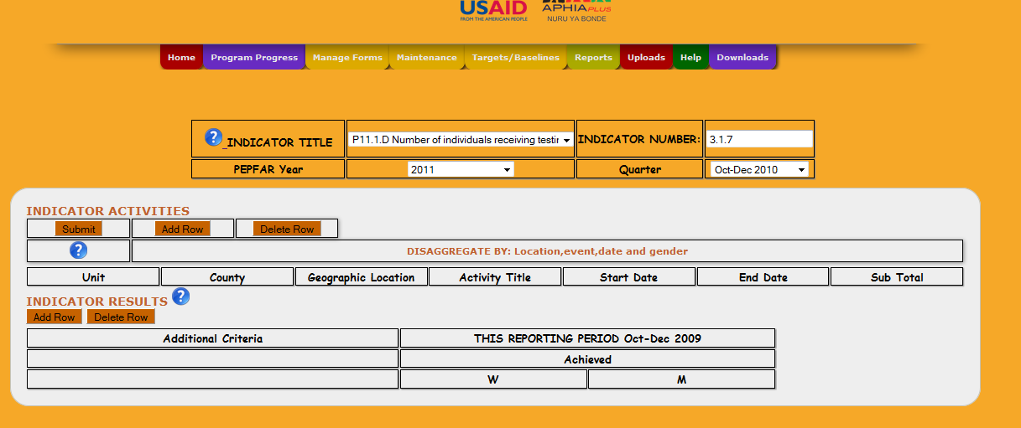
Data Entry Table (Separate)User
Has option for men and women

Slide 14
Data Entry Table(Separate) User
This page allows a distinction of the number of men and women who took part in a specific activity.
The subtotal auto-calculates the total number of men and women.
Select the start date and end date from the calendar generated

Slide 15
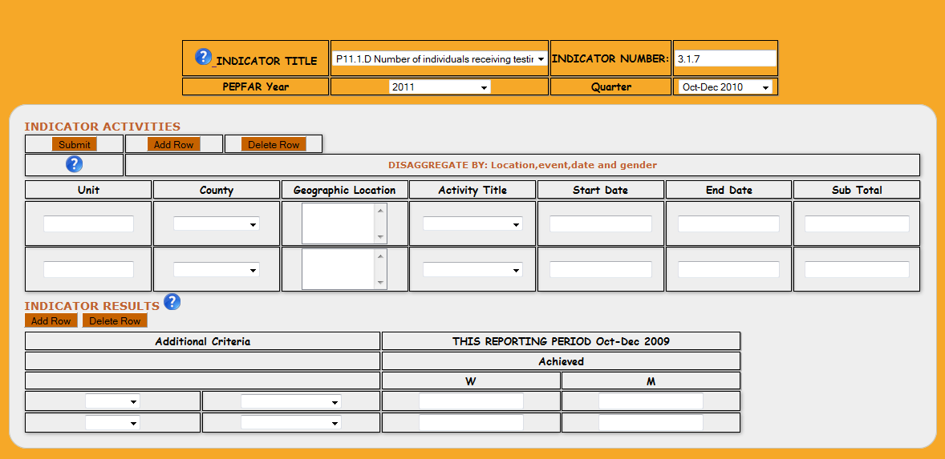
To enter data add rows then enter your data and click submit to save
Enter the activities
Enter the results

Slide 16
View Data
To view the data entered for a specific indicator you have to select the indicator, The financial year the data and the quarter .
The page displays:
Activities entered by the users
The indicator results

Slide 17
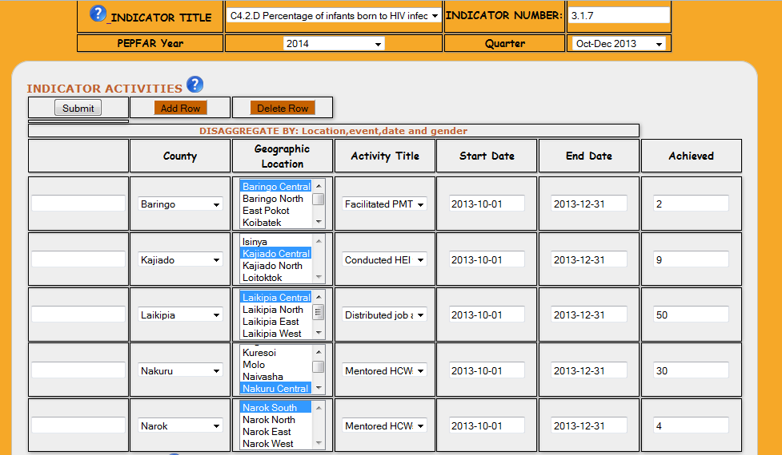
View Data- Activities

Slide 18
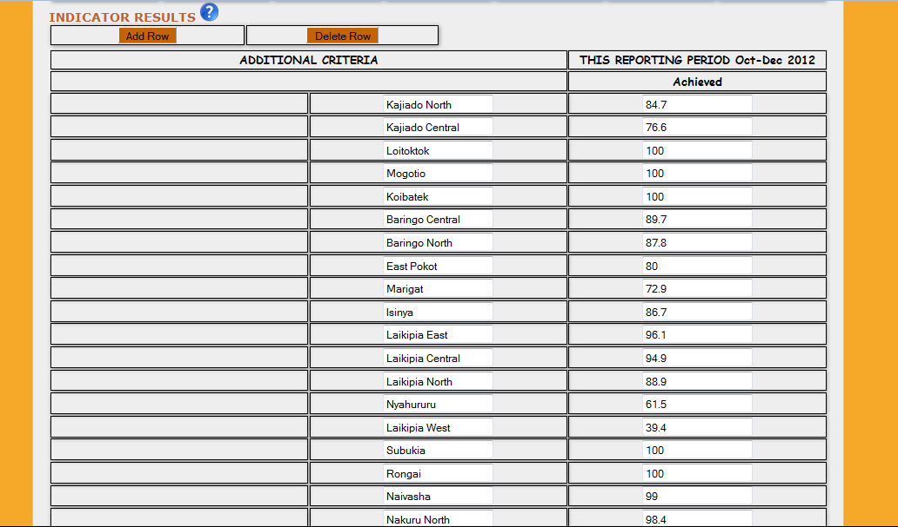
View Data-Results

Slide 19
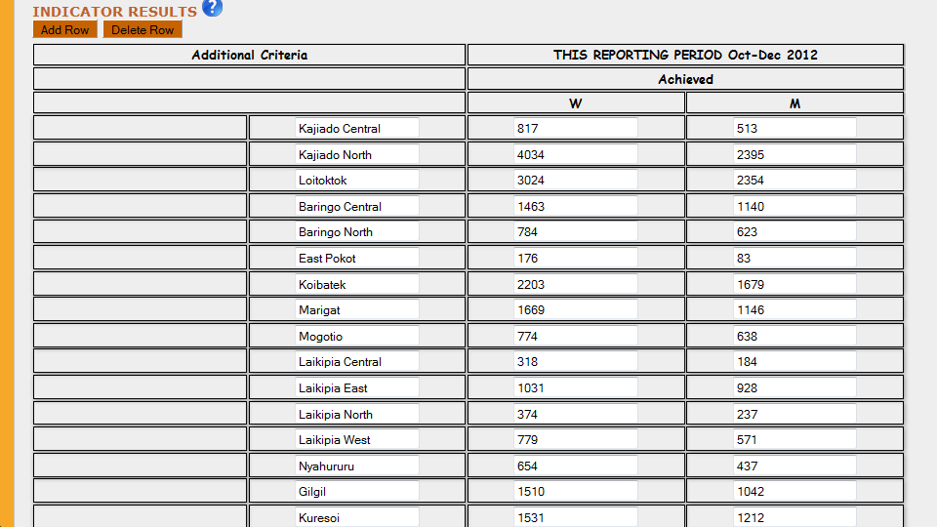
View Data for indicators with men and women, Editing of the data can also be done here

Slide 20
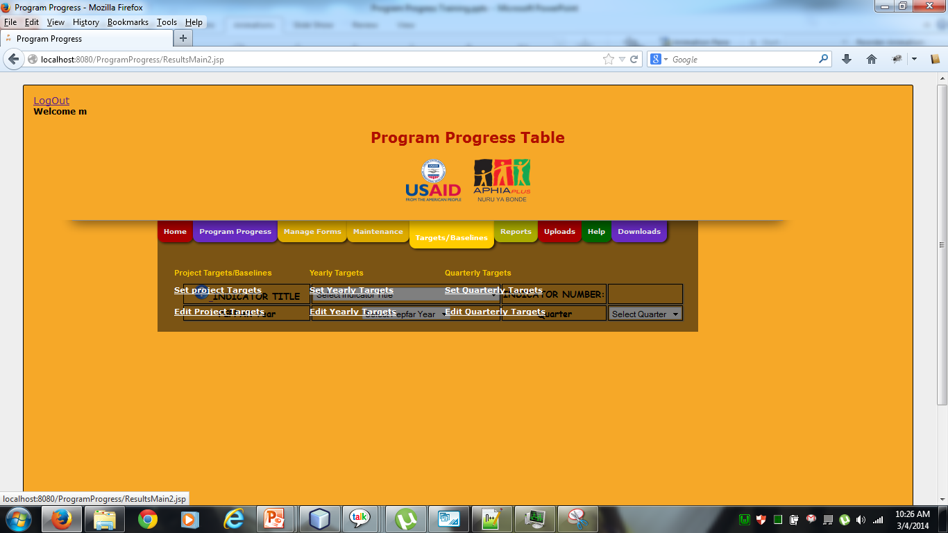
Setting Project, Yearly and Quarterly Targets. Select from the menu either of the targets you want to set

Slide 21
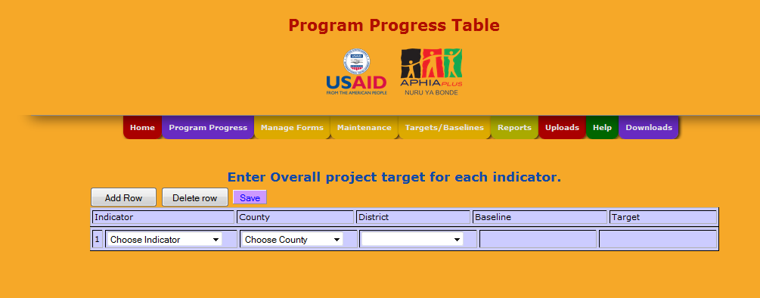
Setting Project Targets
Choose the indicator, choose a county, district then the baseline and target column will be editable

Slide 22
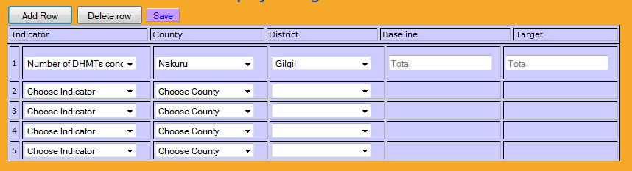
Data Entry form for baseline and targets
After pressing add row you can enter baseline and targets for other indicators

Slide 23
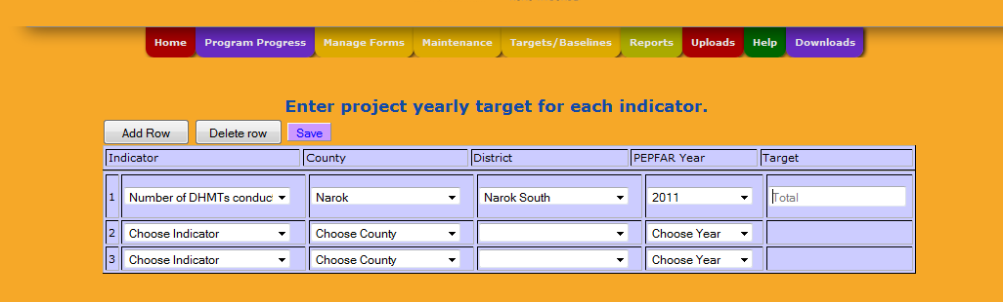
Setting Yearly Targets
The Procedure is:
Select Indicator
Select County
Select Districts
Select Year
Enter the Target
Select Quarter

Slide 24
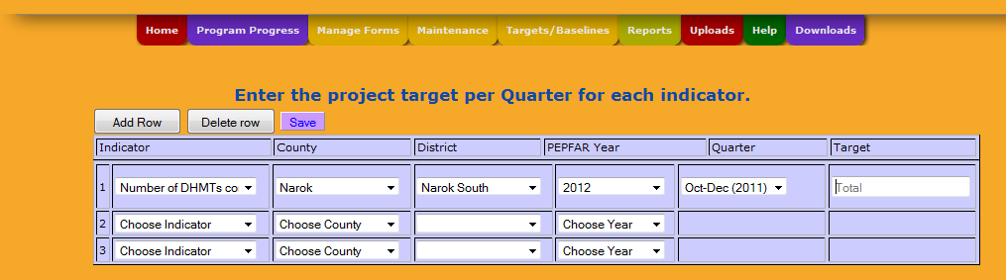
Setting Quarterly Targets
The Procedure is:
Select Indicator
Select County
Select Districts
Select Year
Select Quarter
Enter the Target
Select Quarter

Slide 25
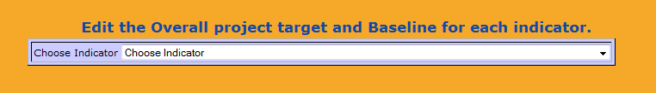
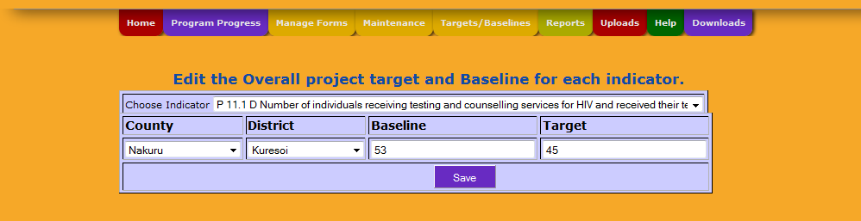
Edit Project Target
Go to menu > Edit Project Targets.
This appears:
Select Indicator then you want to edit targets for then this appears:

Slide 26

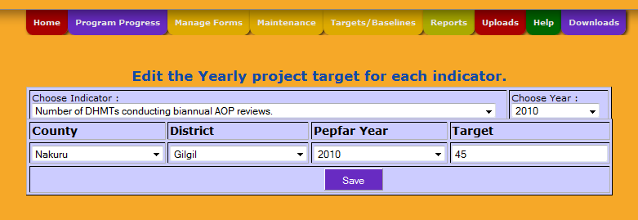
Edit Yearly Targets
Go to menu > Edit Yearly Targets.This appears:
Select Indicator and year that you want to edit targets for then this appears:

Slide 27

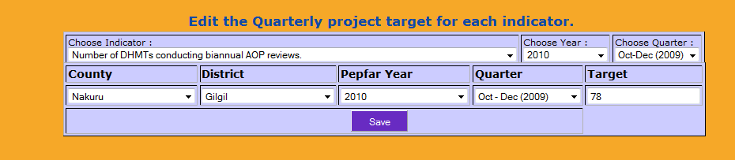
Edit Quarterly targets
Go to menu > Edit Quarterly Targets. This appears:
Select Indicator, year, quarter that you want to edit targets for then this appears:

Slide 28
Maintenance Module
This module allow users to maintain the Districts and Counties by either adding new counties or districts, deleting and also editing.
For the admin, the module allows them to add, edit, delete districts, counties , indicators and baselines.

Slide 29
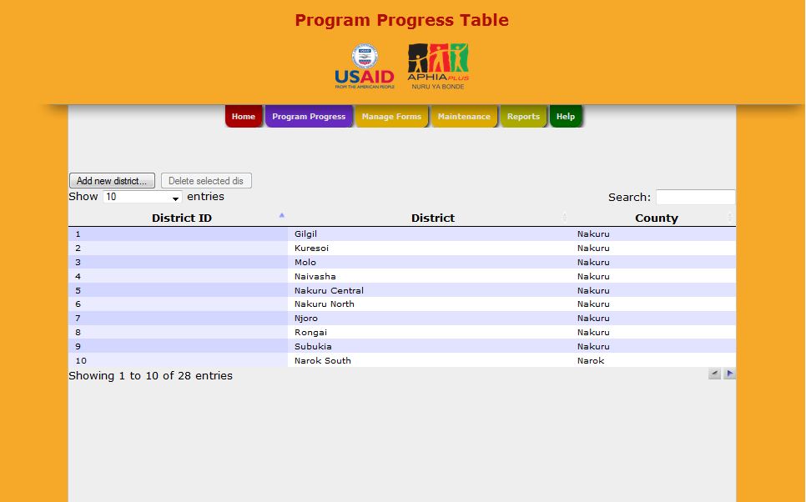
Maintain Districts

Slide 30
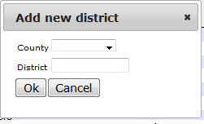
Maintain Districts
This module allows a user to edit a districts by clicking on the specific cell a user wants to edit .
On clicking add a popup appears as shown;
Deleting requires selected a row then clicking the delete button.

Slide 31
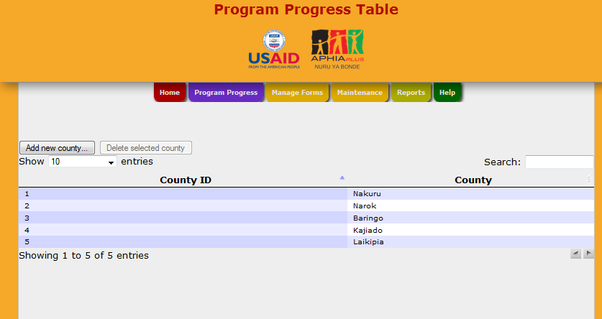
Maintain Counties

Slide 32
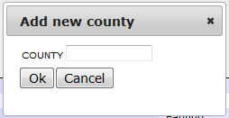
Maintain Counties
This module allows a user to edit a county by clicking on the specific cell a user wants to edit .
On clicking add county, a popup appears as shown;
Deleting requires selected a row then clicking the delete button.

Slide 33
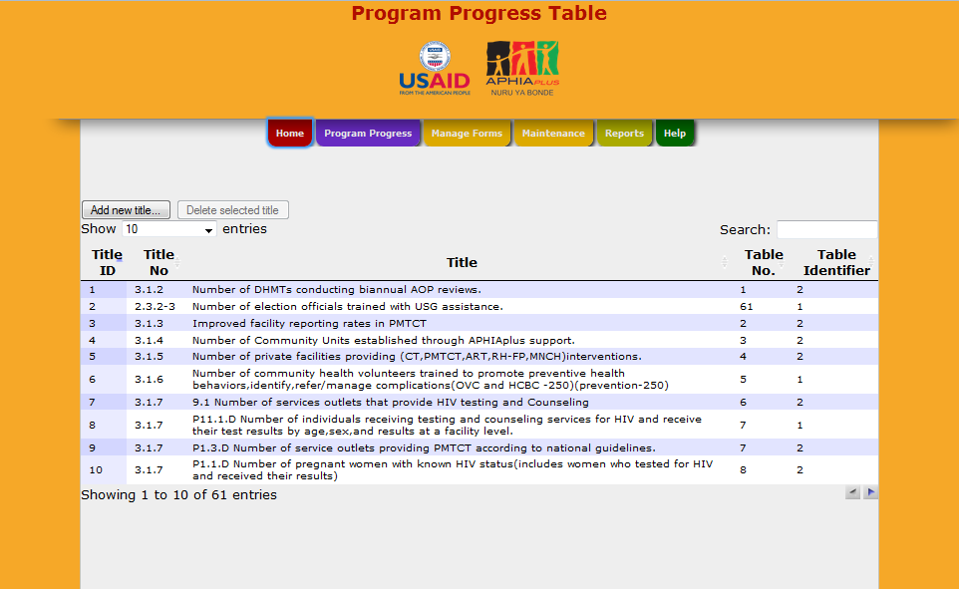
Maintain Indicators

Slide 34
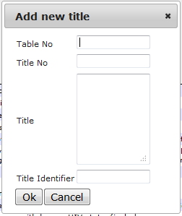
Maintain Indicators
This module allows a user to edit an indicator by clicking on the specific cell a user wants to edit.
On clicking add indicator title, a popup appears as shown;
Deleting requires selected a row then clicking the delete button.

Slide 35
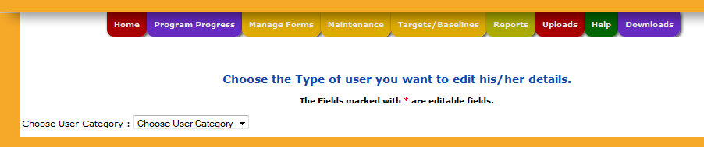
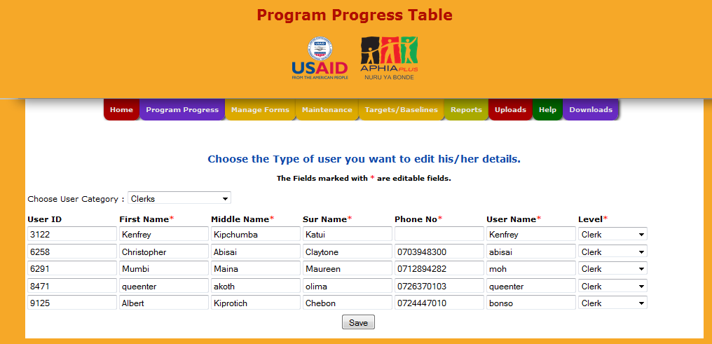
Edit user details(Admin)
Go to menu>maintenance>edit user details. Select the category of user
Then this appears

Slide 36
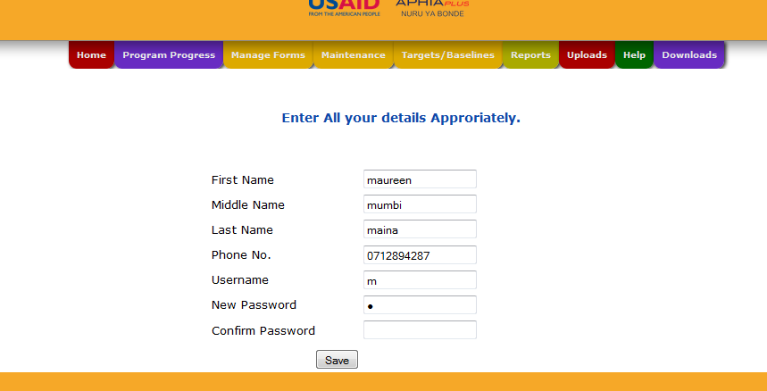
Edit Your Details
This module allows a user to edit all their details.

Slide 37
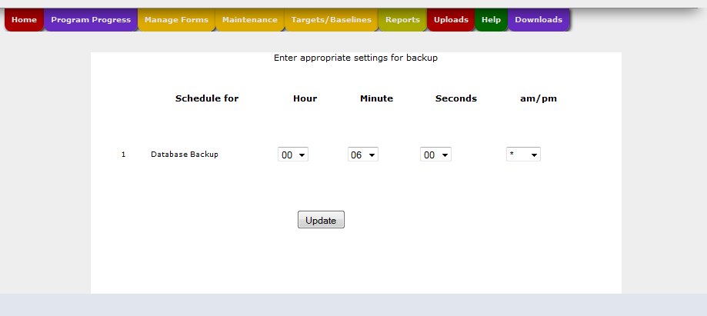
Scheduling database backups
Go to menu>maintenance>backup scheduler. Set the time in hours, minutes ,seconds, am and pm.

Slide 38
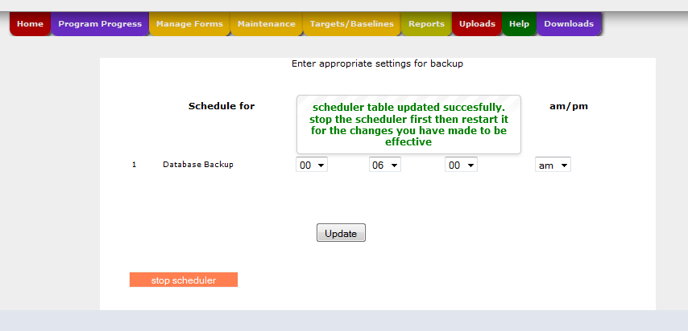
Click Update , the stop and restart the scheduler so that the changes can be effective , a data backup is done automatically when the time arrives
Stop scheduler then restart it

Slide 39
Manage Form Module
This Module is an additional module that allows a user to view all the activities and results entered by the user into the database and allows them to edit and delete them.

Slide 40
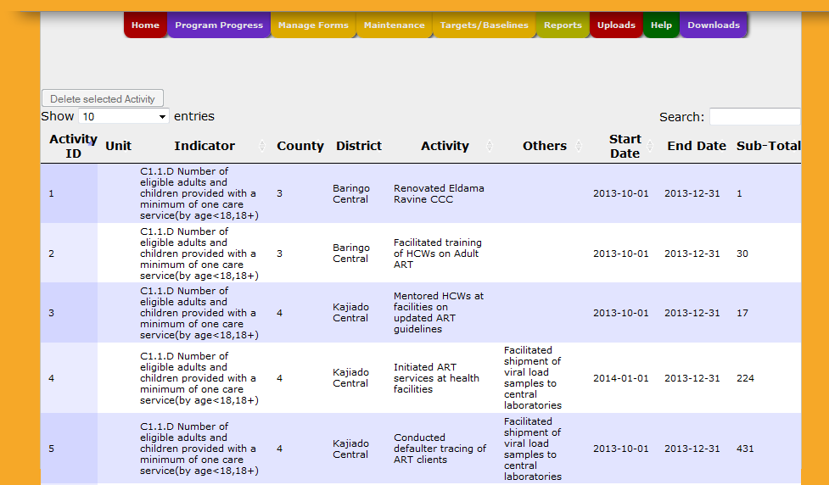
Manage Forms
Go to manage forms>separated indicator activities then search for an indicator you want to edit on, then double click on the data you need to edit and save changes

Slide 41
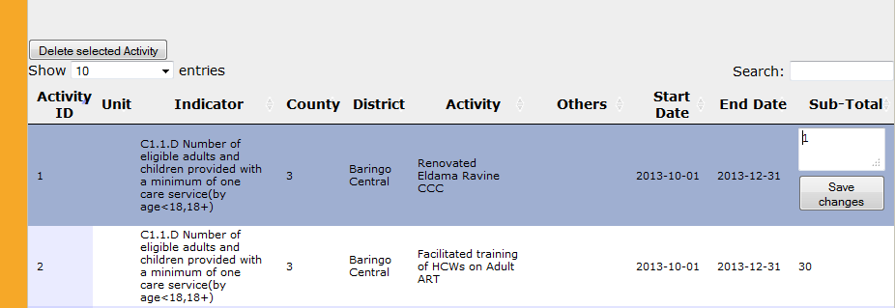
To Edit activities
Double click on what you need to edit then click on save changes

Slide 42
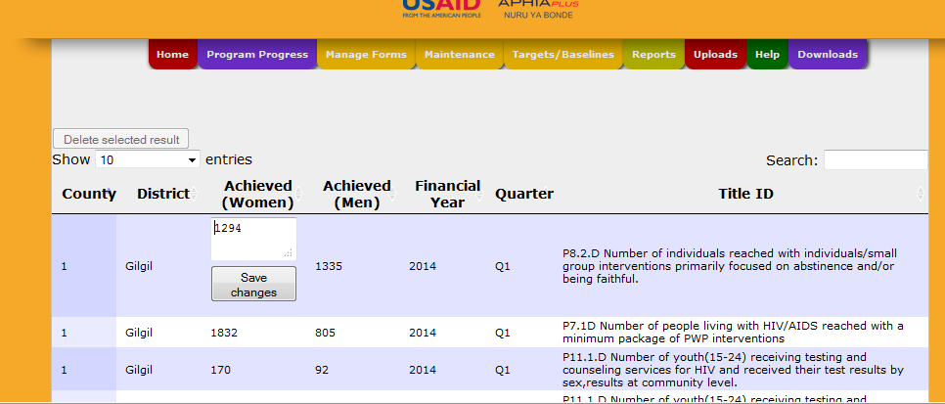
To edit results, double click on the data you want to edit then click save changes

Slide 43
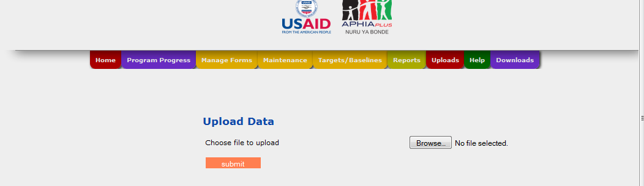
Upload Module
Go to uploads>upload data, then this appears
Click on browse, n select a file to upload form a folder drive C> ppt uploads

Slide 44
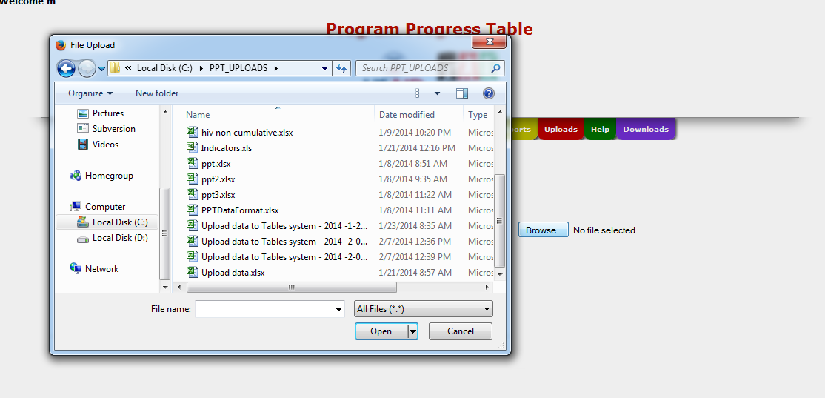
Select the file then click submit

Slide 45
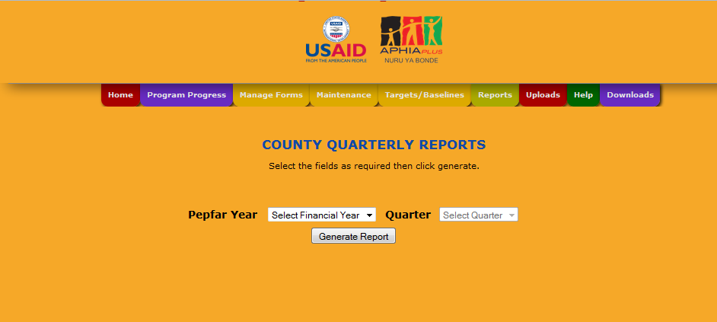
Reports
Go to menu>reports>select either county or district report then this appears. Select the Year and Quarter then click generate report.

Slide 46
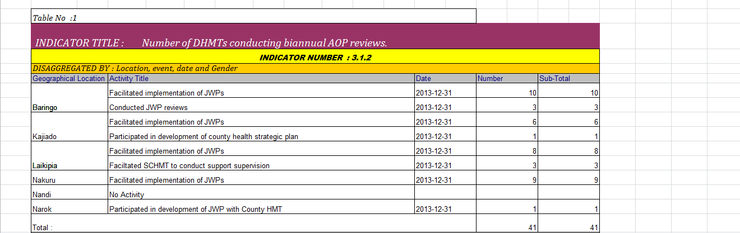
County report –Activities

Slide 47
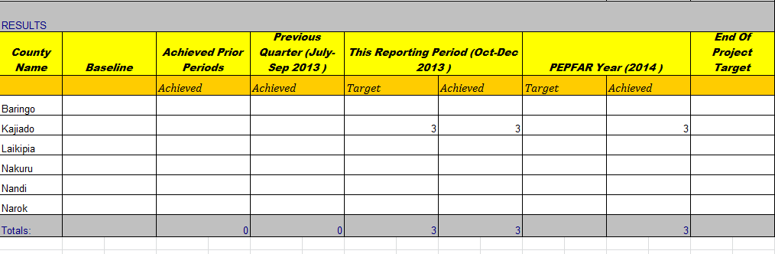
County Report –Results

Slide 48
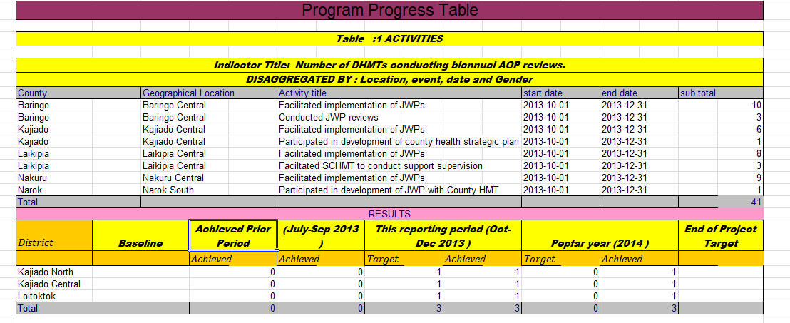
District Report – Activities and Results

Slide 49
THE END

